Slide 1
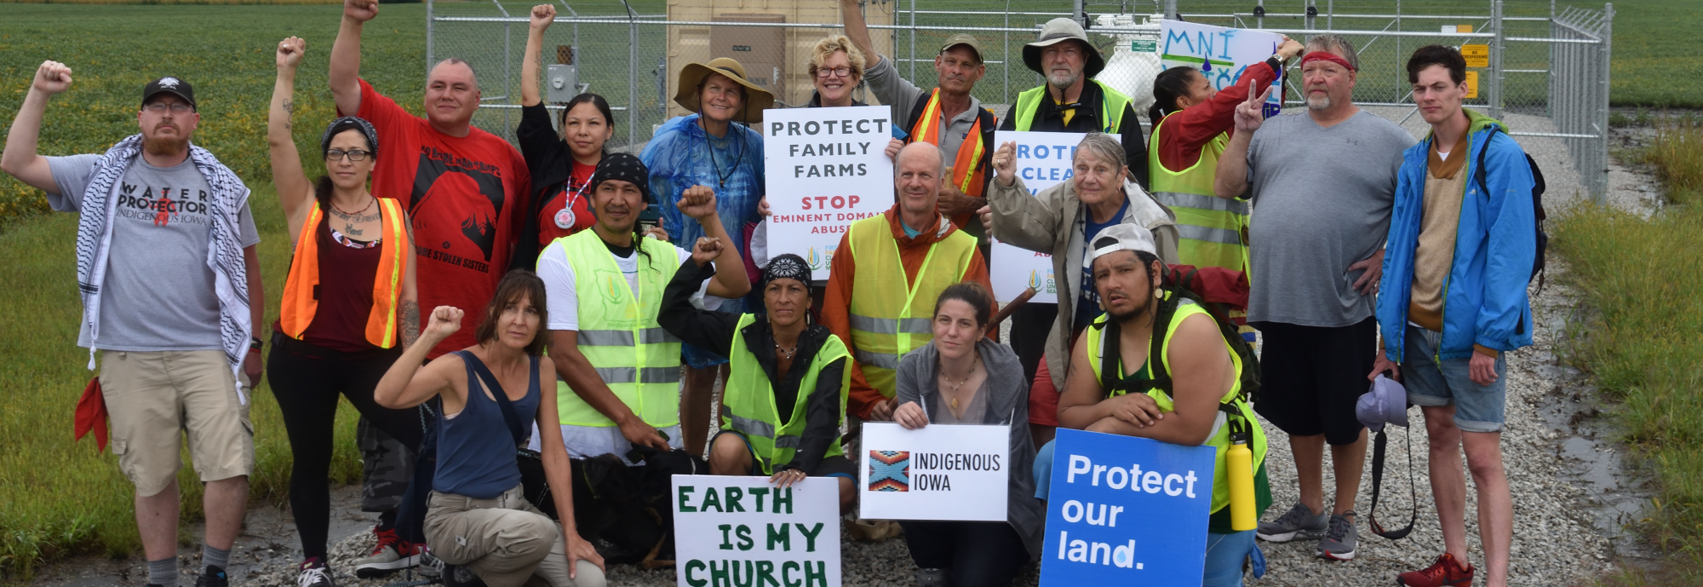
Mutual Aid
The Quaker Way of Being in the World
Jeff Kisling

Slide 2
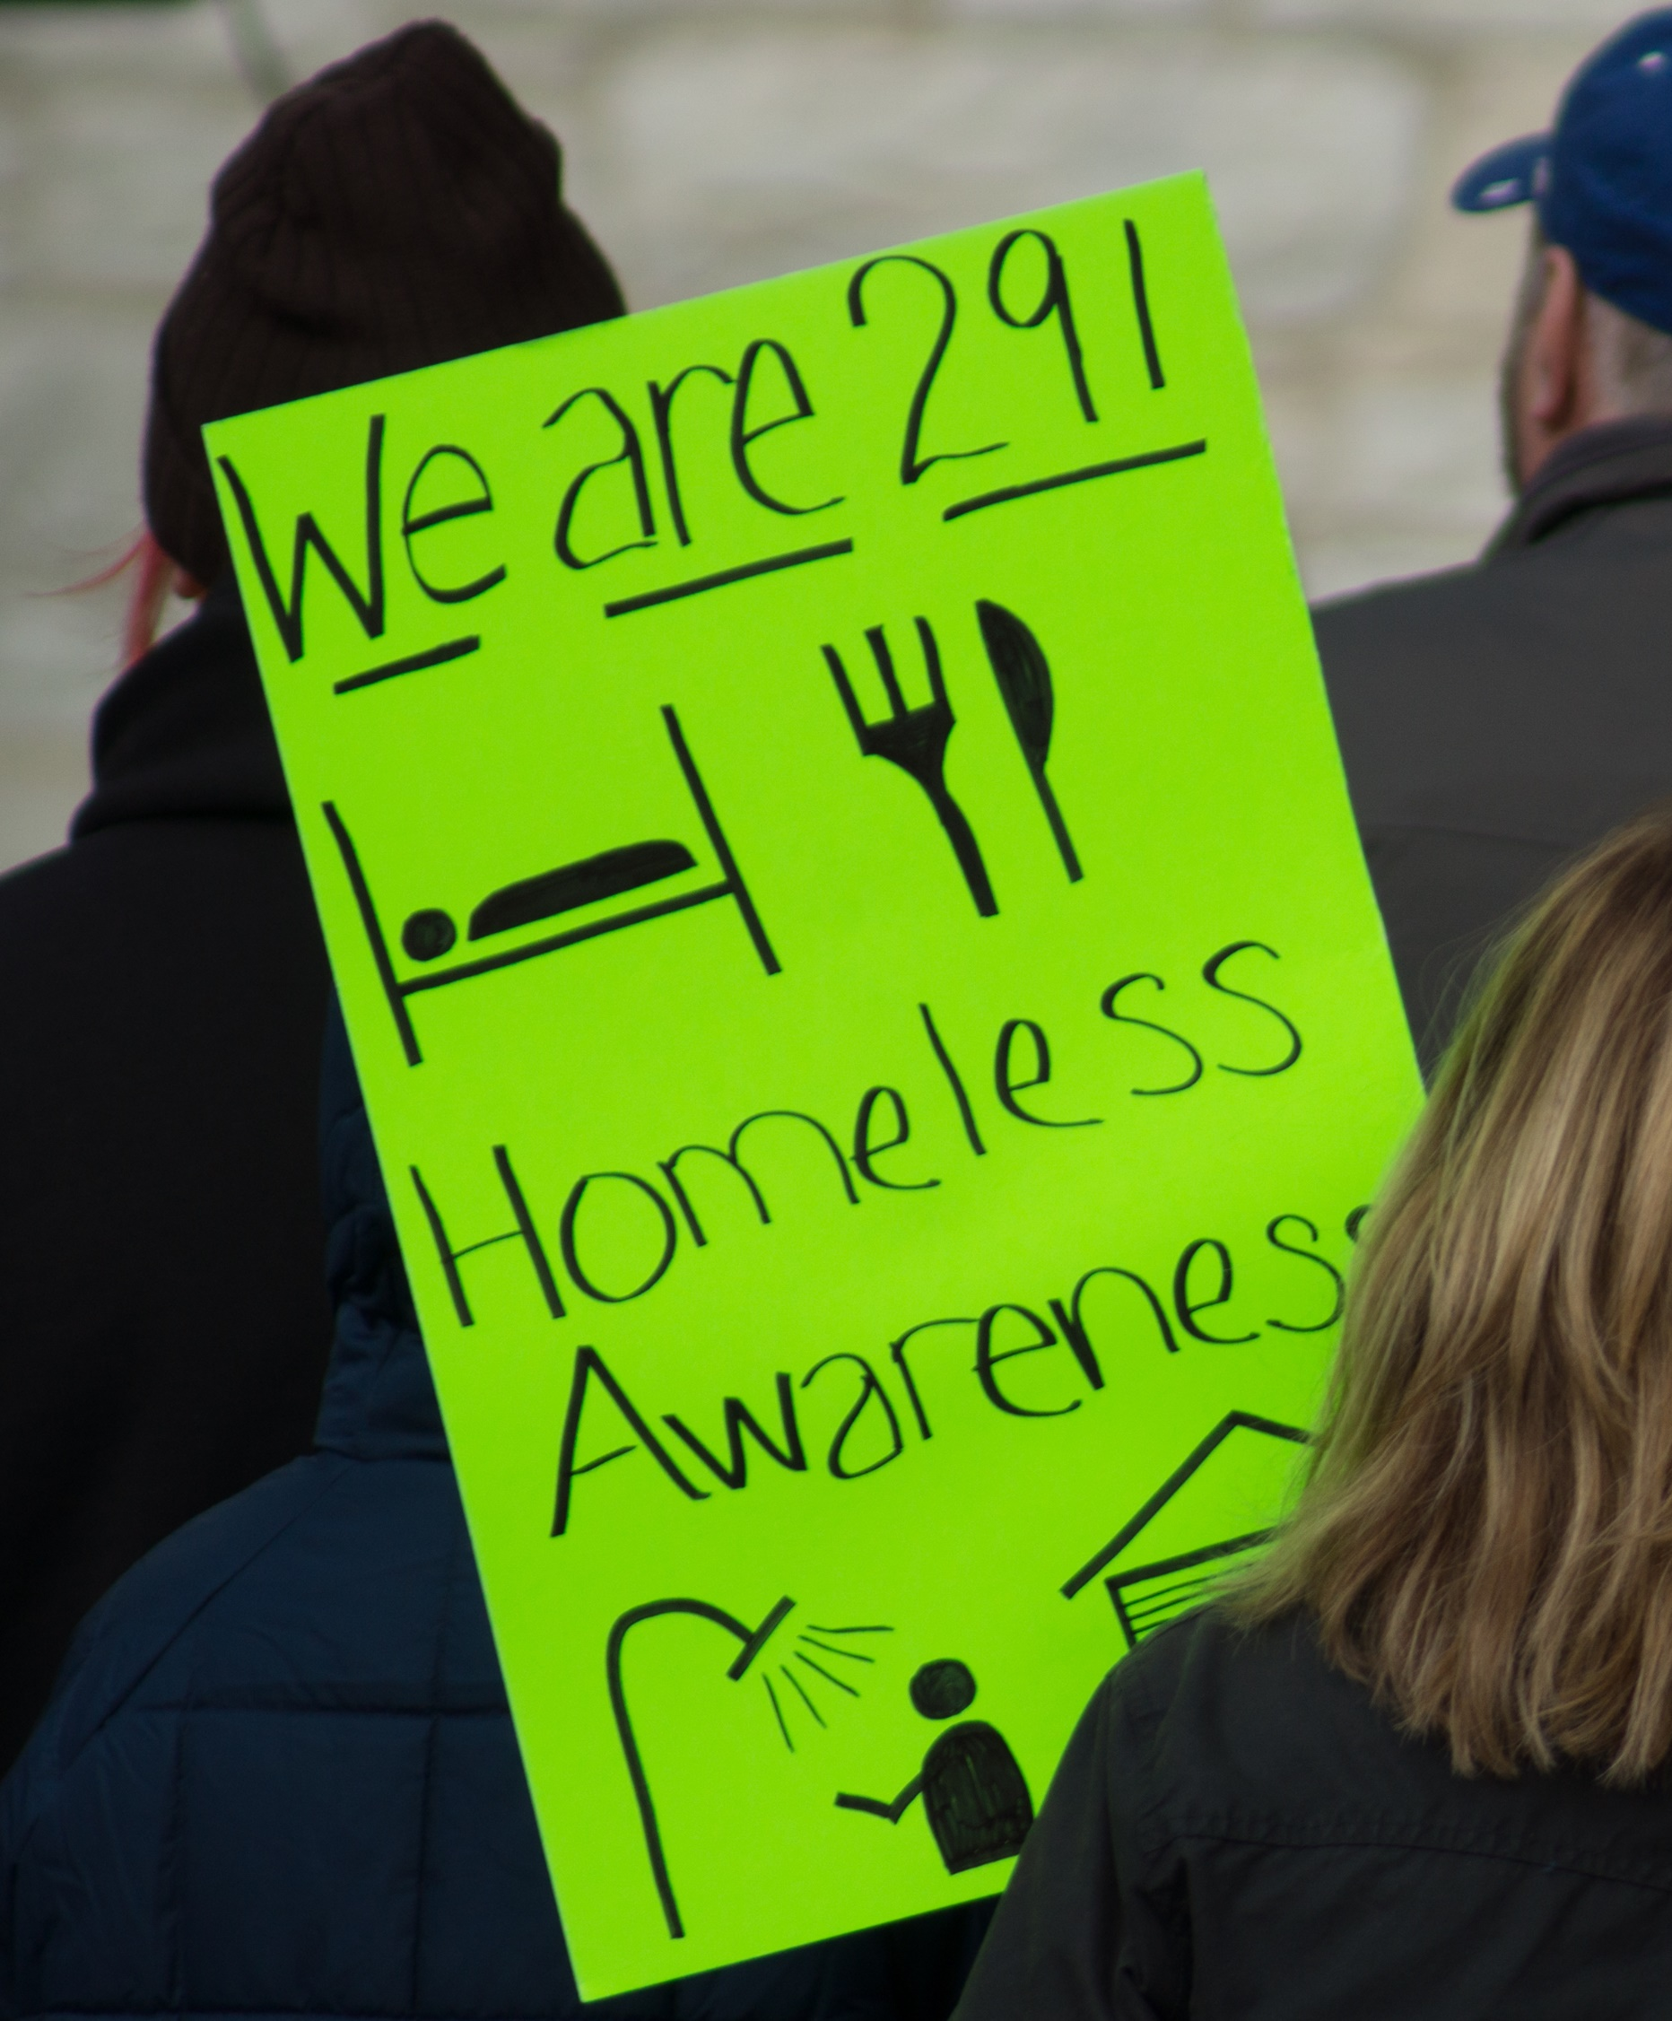
Problems with capitalism
Increasing unemployment
  Automation
  Jobs moved overseas
  Economic impact of COVID
Millions no longer have income to pay for goods and services
Increasing reliance on shrinking social safety nets
Poverty

Slide 3
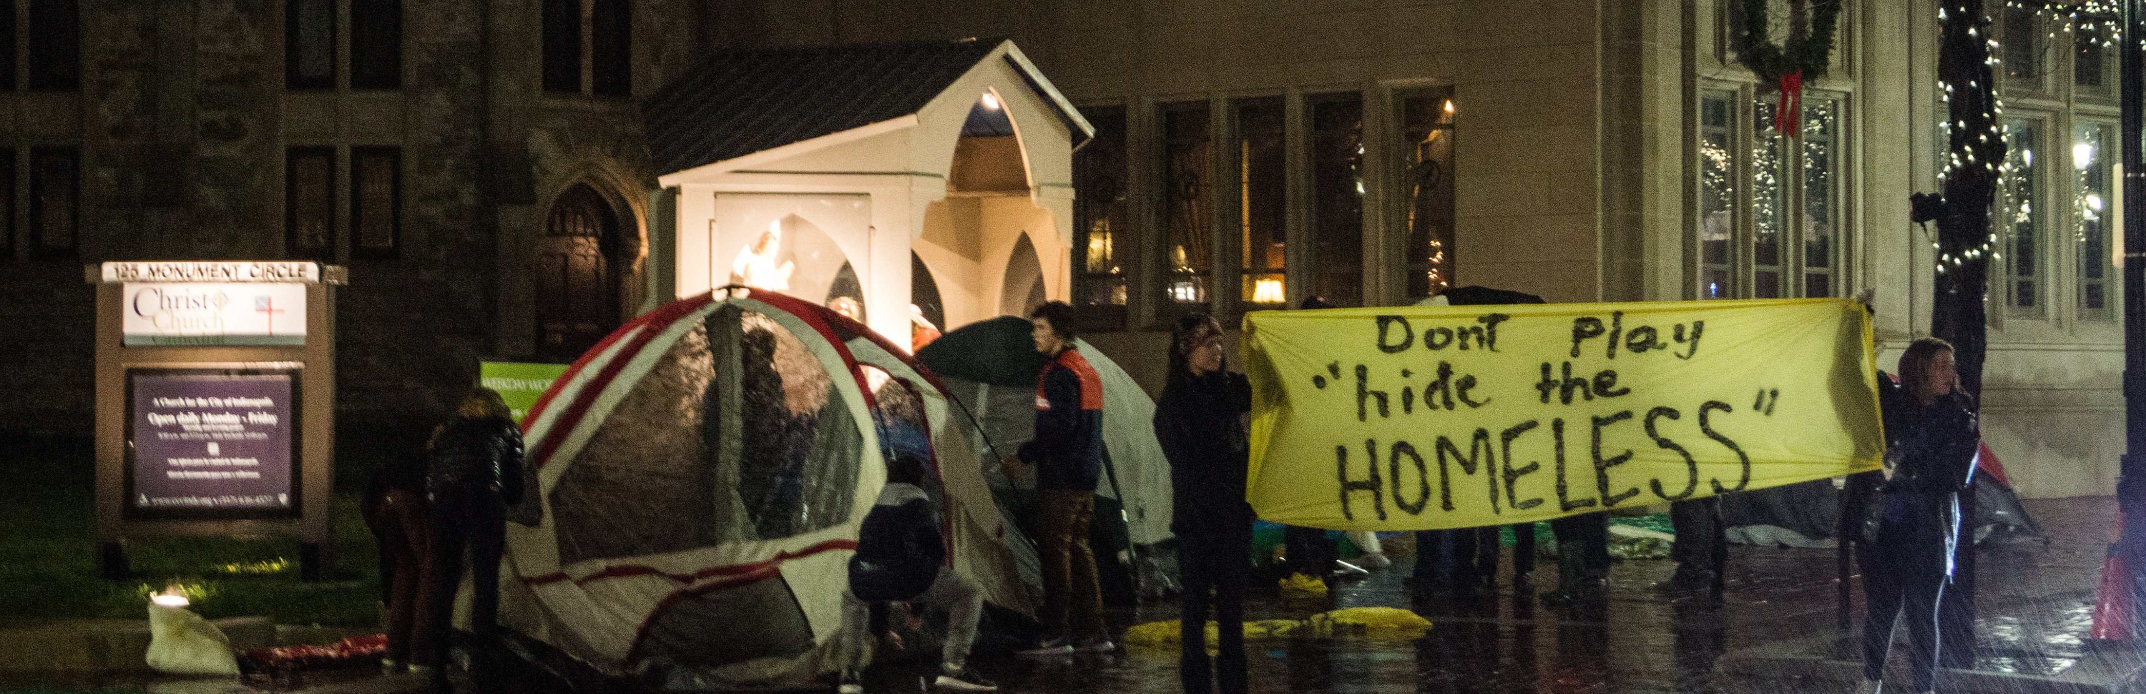
Problems with capitalism
Capitalism is an unjust, untenable system when there is plenty of food in grocery stores but men, women and children are going hungry, living on the streets outside.

Slide 4
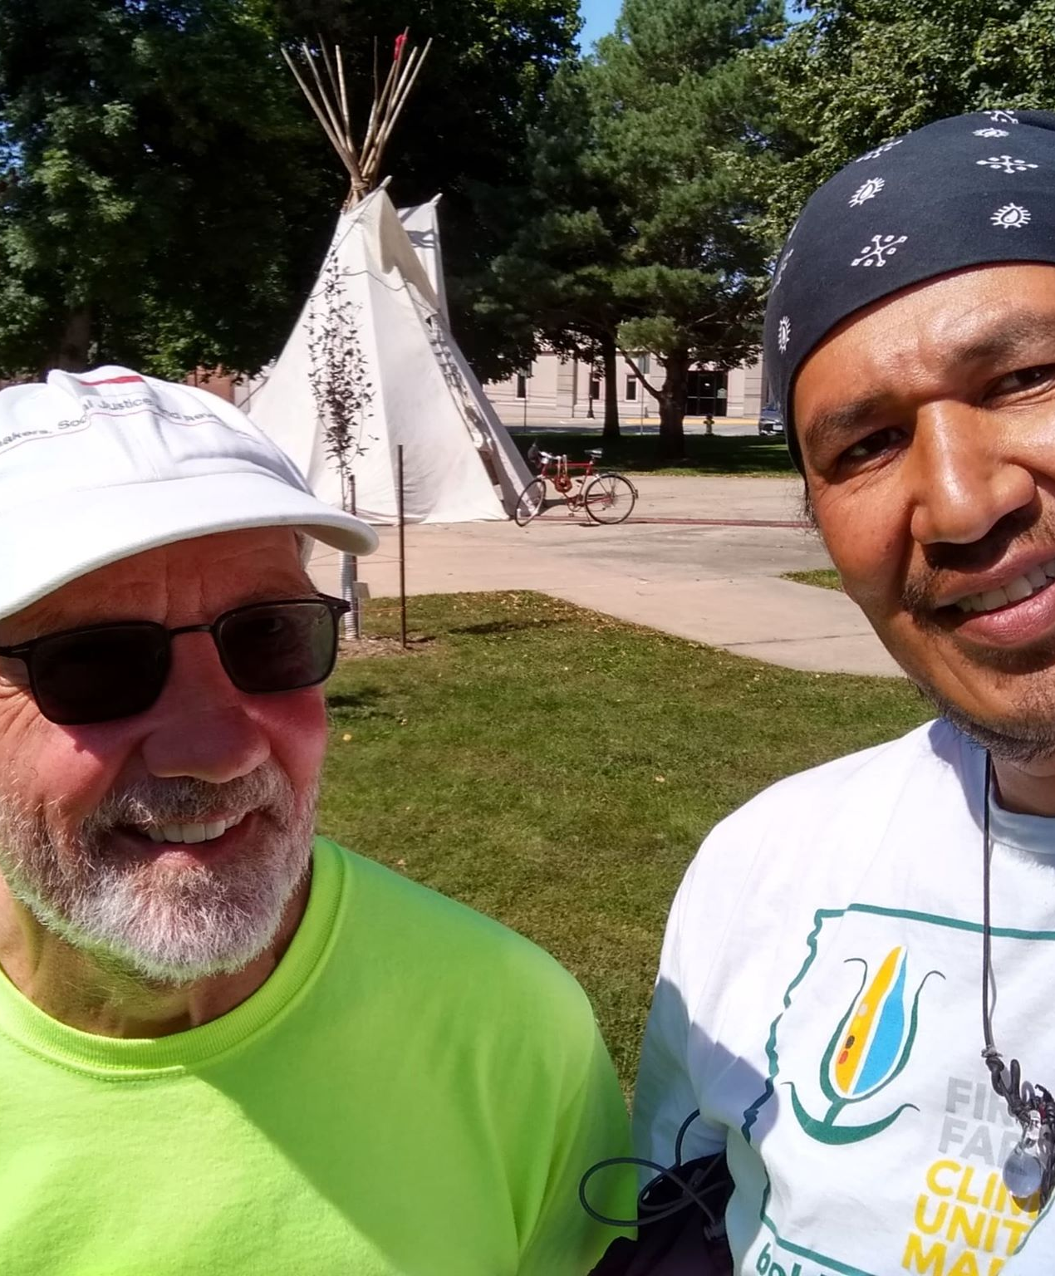
Capitalism and colonialism
… capitalism and colonialism created structures that have disrupted how people have historically connected with each other and shared everything they needed to survive.
Dean Spade. Mutual Aid: Building Solidarity During This Crisis (and the Next) (Kindle Locations 111-113). Verso.

Slide 5
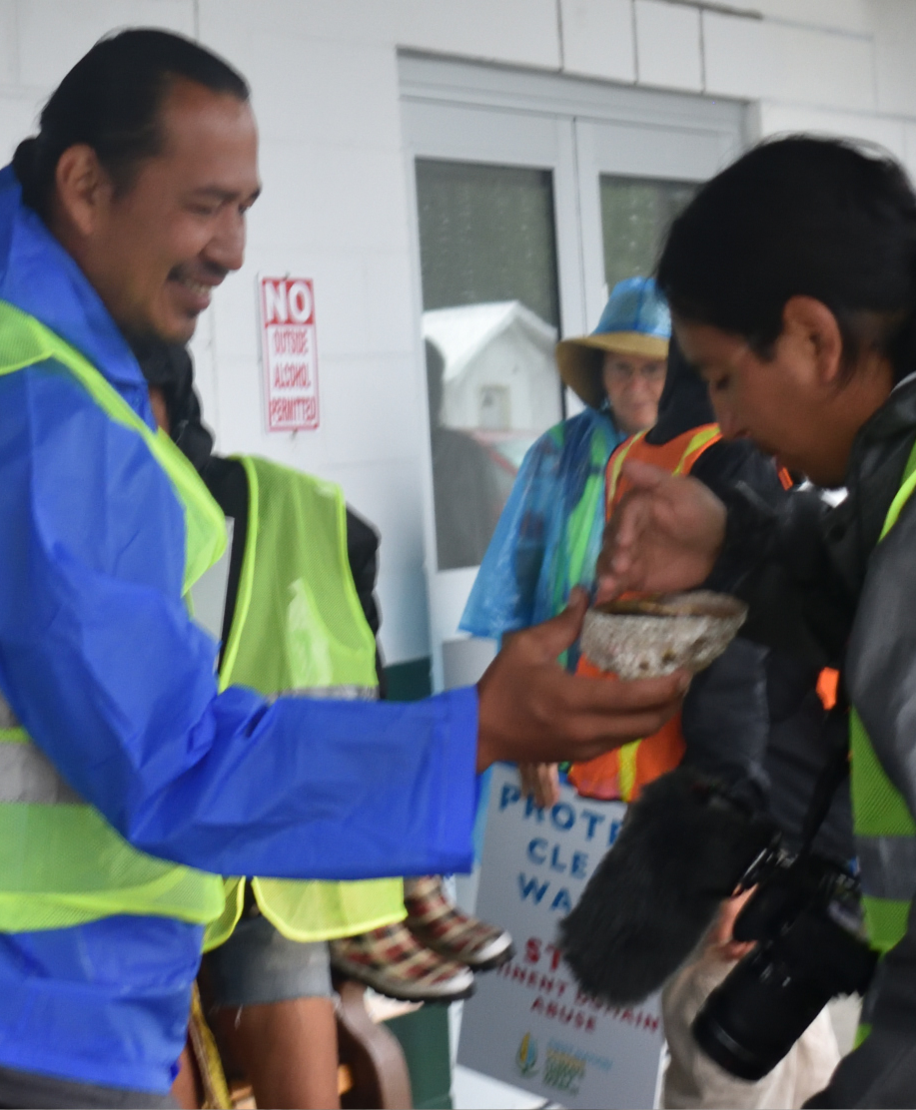
Capitalism and colonialism
As people were forced into systems of wage labor and private property, and wealth became increasingly concentrated, our ways of caring for each other have become more and more tenuous.
Dean Spade. Mutual Aid: Building Solidarity During This Crisis (and the Next) (Kindle Locations 111-113). Verso.

Slide 6
Decolonize
Mutual Aid represents a return to Indigenous ways

Slide 7
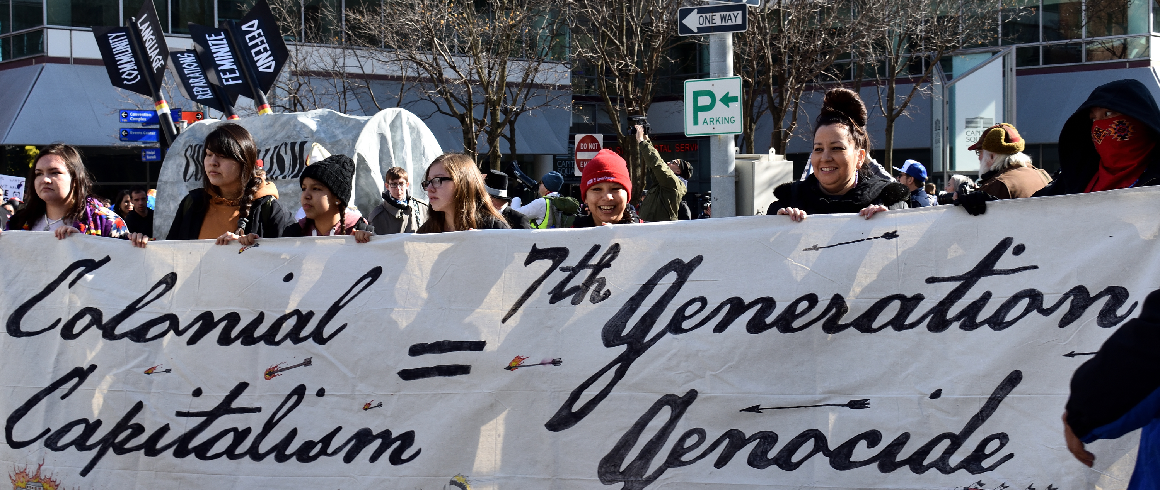
Colonial Capitalism
7th Generation Genocide

Slide 8
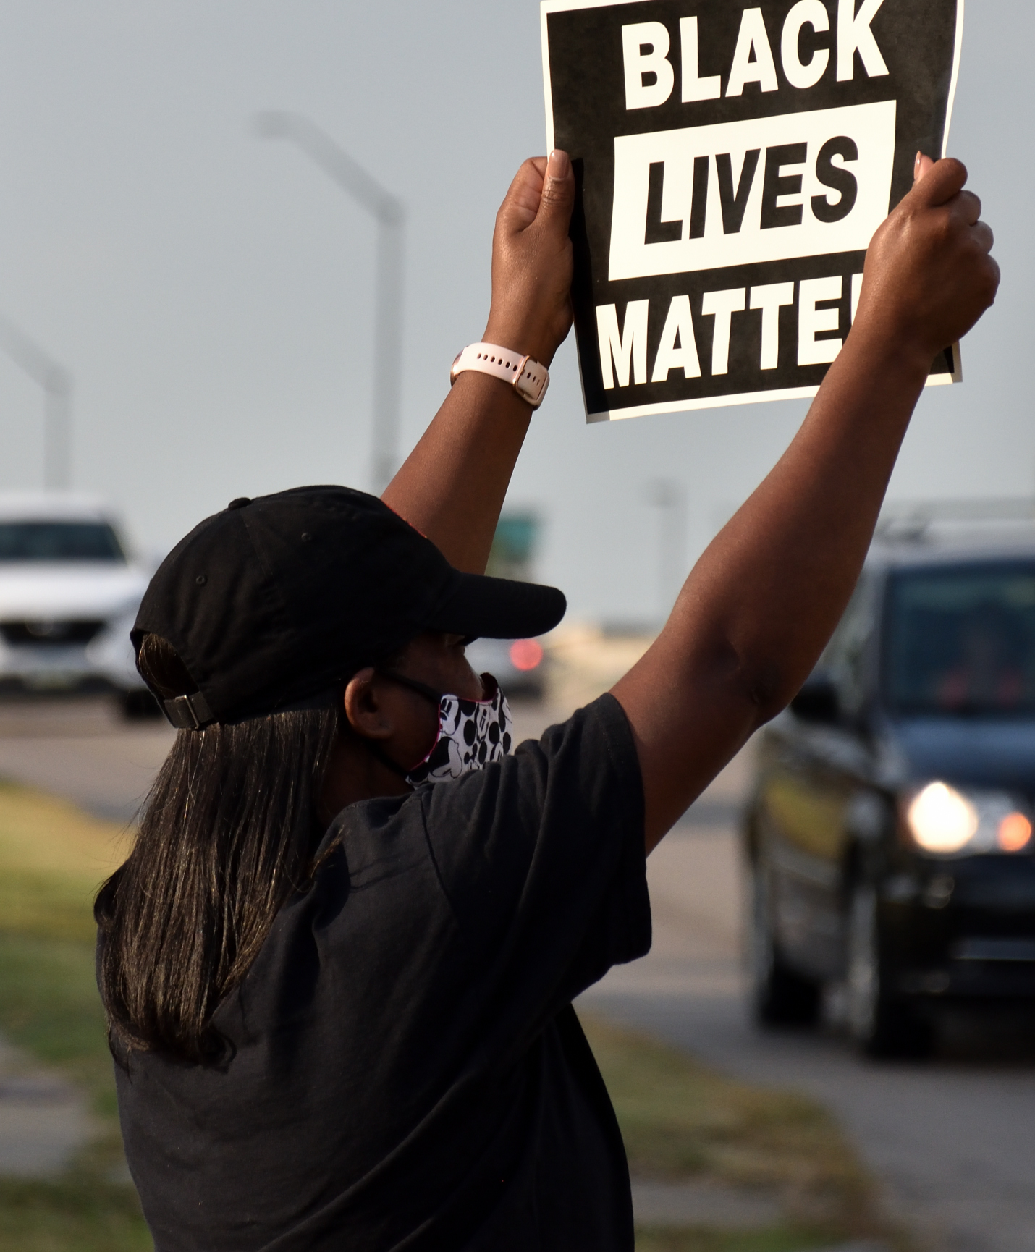
Black Liberation
mutual aid is the new economy
mutual aid is community
capitalism has violated the communities of marginalized folks
in the name of liberation, capitalism must be reversed and dismantled.
meaning that capitalistic practices must be reprogrammed with mutual aid practices
Des Moines Black Lives Matter

Slide 9
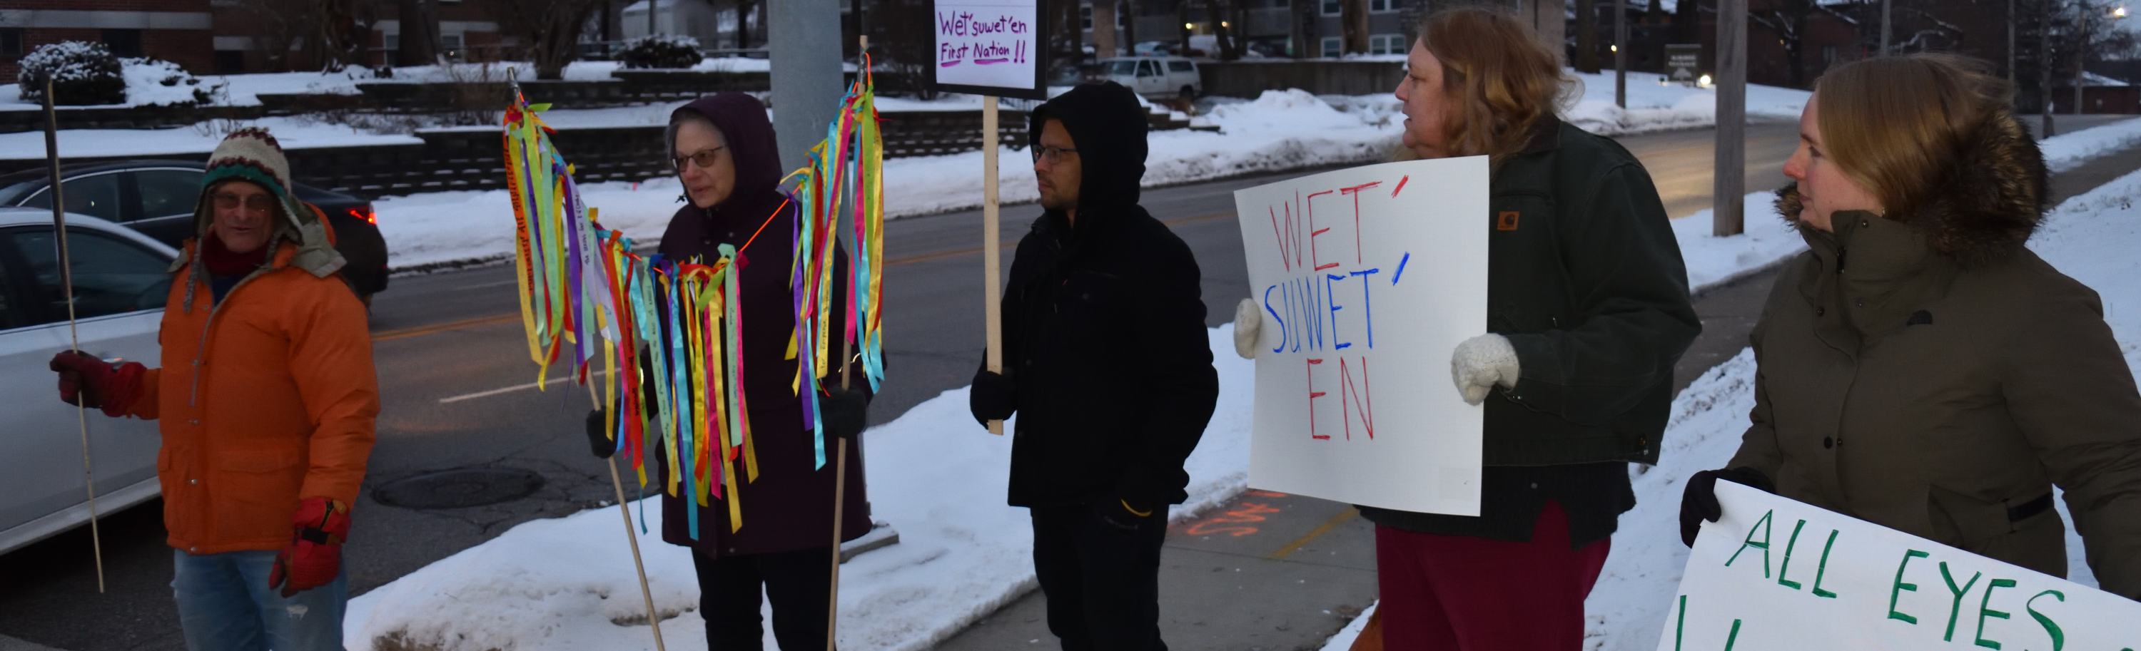
How I learned about Mutual Aid
Spirit led
Vigil for Wet’suwet’en
Ronnie James attends
Indigenous organizer
Mentor – teaching me about Mutual Aid

Slide 10
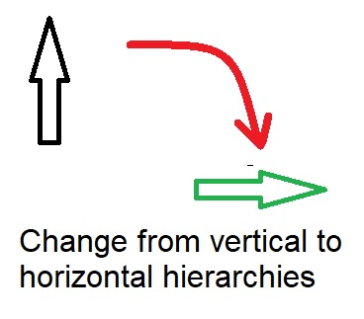
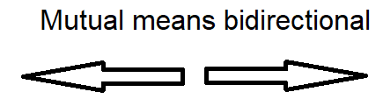
Key Elements of Mutual Aid

Slide 11
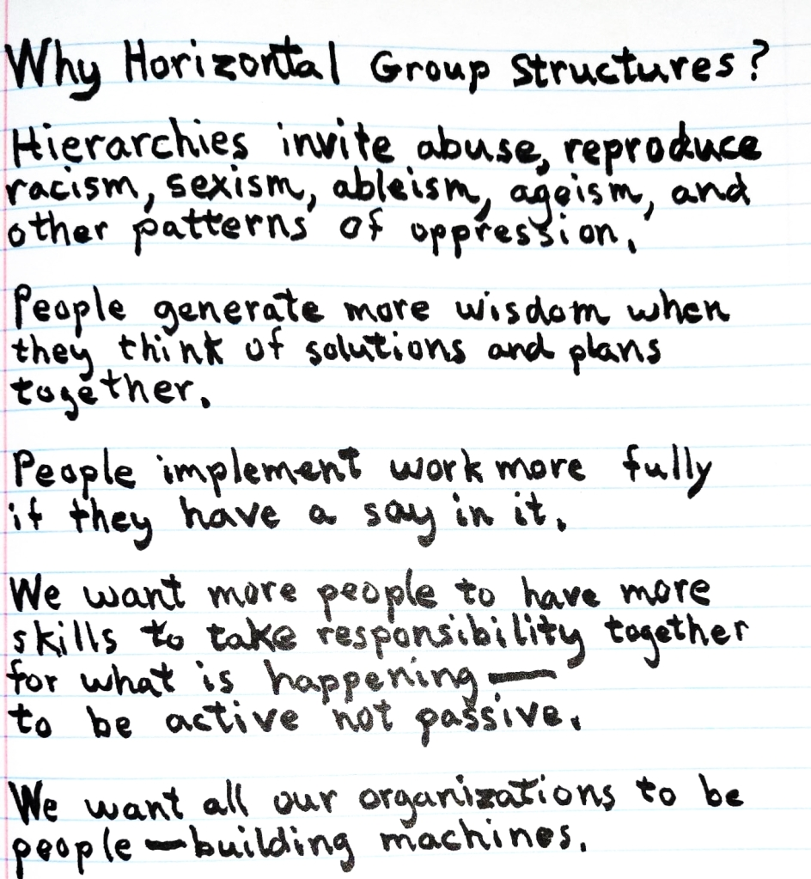
Hierarchy

Slide 12
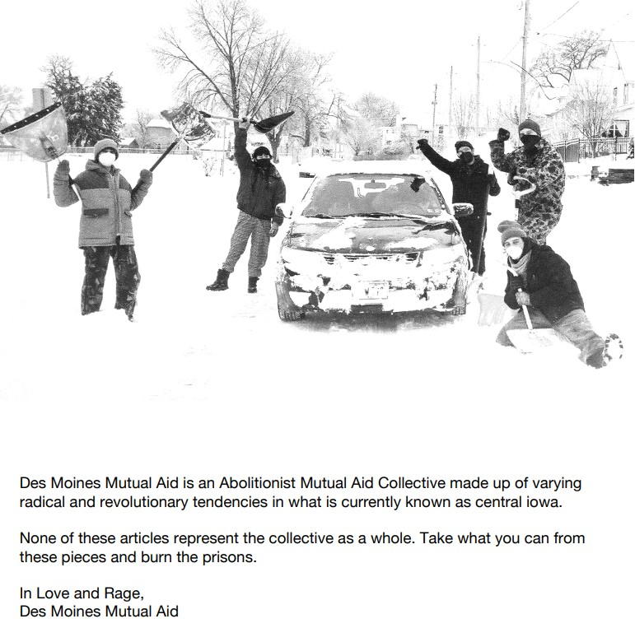
Key Elements of Mutual Aid
Work to meet survival needs and build shared understanding about why people do not have what they need.
Mobilize people, expand solidarity, and build movements.
Participatory, solving problems through collective action rather than waiting for saviors.

Slide 13
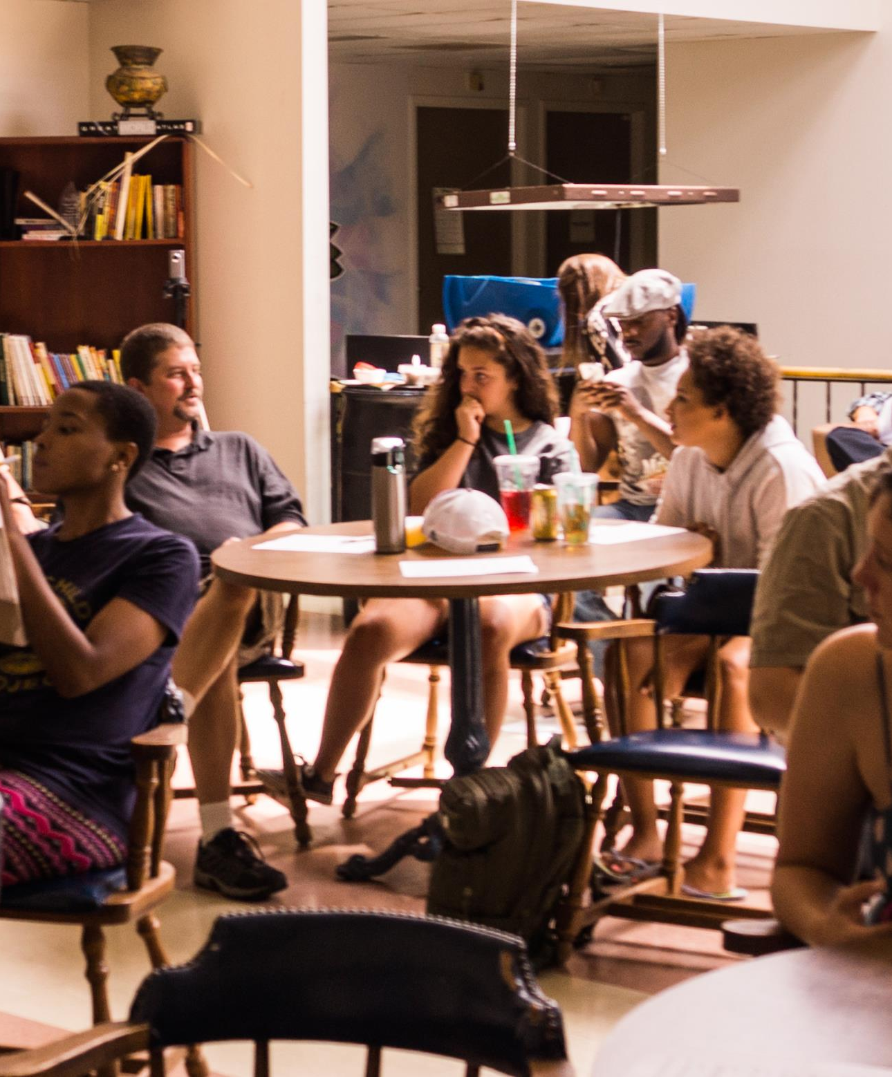
What is Mutual Aid?
Sharing things rather than hoarding things
Treating no one as disposable
Providing all kinds of support, ranging from
  Food
  Childcare
  Spiritual
  Emotional support
  Safety
  Medical
  Recognizing the value of every person

Slide 14
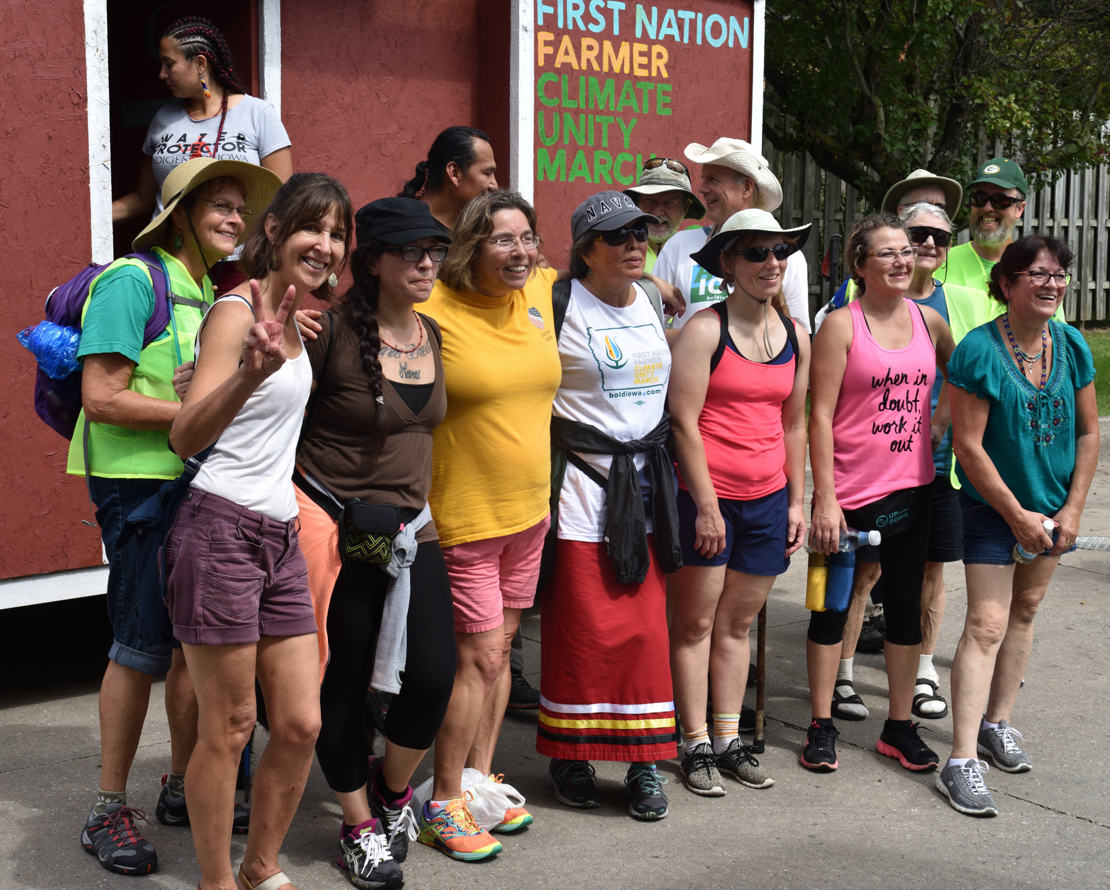
Mutual Aid is not…
Quid pro quo transactions
Only for disasters or crises
A reason for a social safety net not to exist
NOT Charity

Slide 15
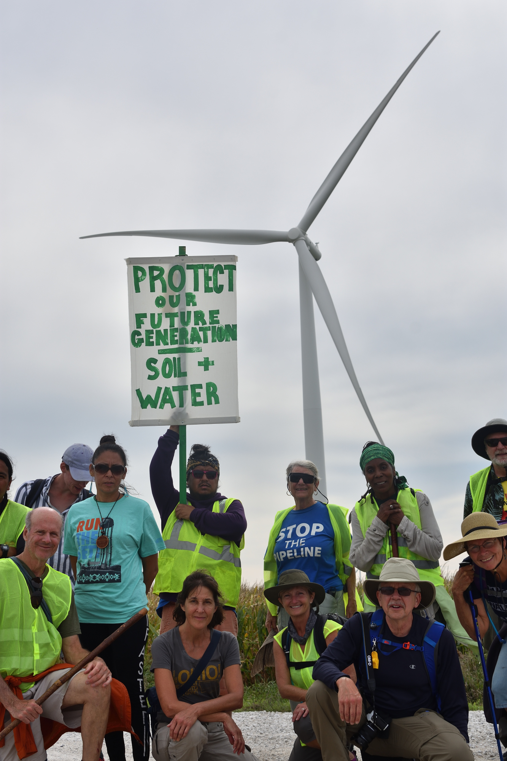
Mutual aid is inherently anti-authoritarian
Demonstrating how we can do things together in ways we were told not to imagine
We can organize human activity without coercion
Most people have never been to a meeting where there was not a boss or authority figure with decision-making power.
Most people work or go to school inside hierarchies where disobedience leads to punishment or exclusion.
“Mutual Aid is essential to our survival” by Dean Spade, Truthout, October 28, 2020

Slide 16
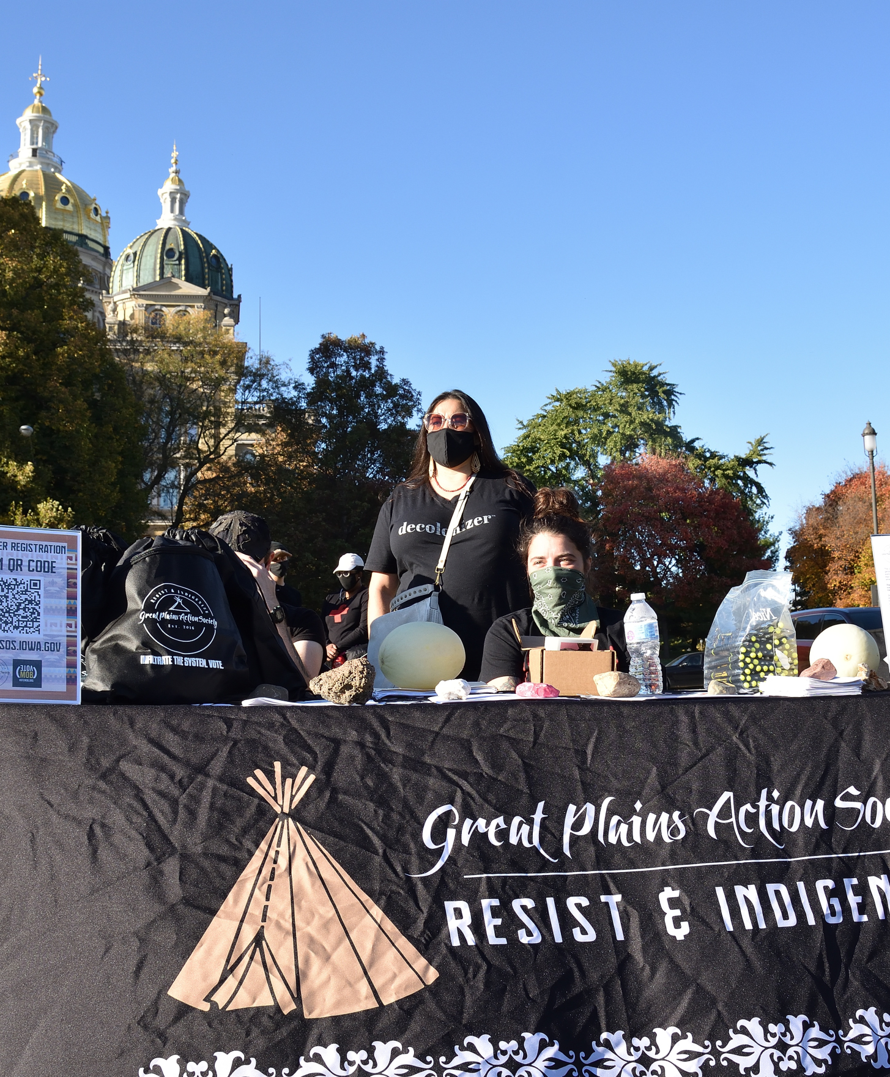
Work locally
Rather than disengage and feel powerless, mutual aid allows us to plug in where we can make the most impact — locally.

Slide 17
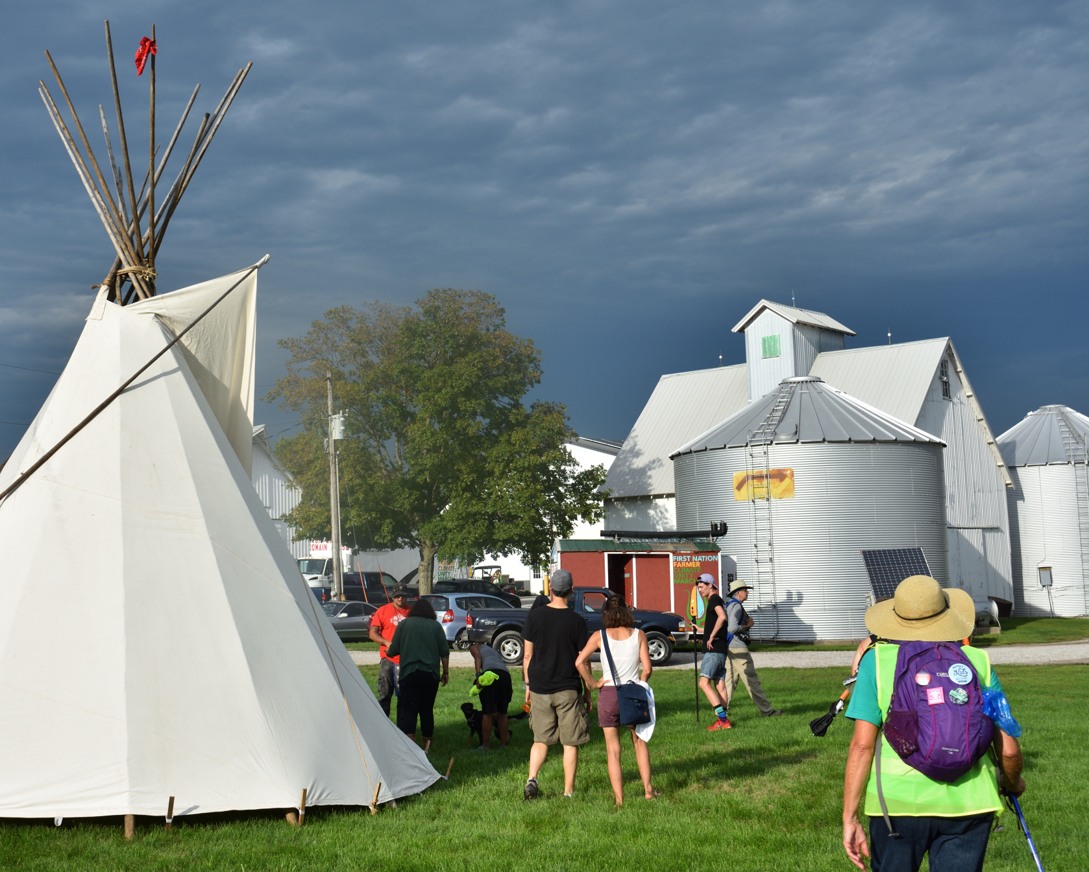
A Tool of Revolution

Slide 18
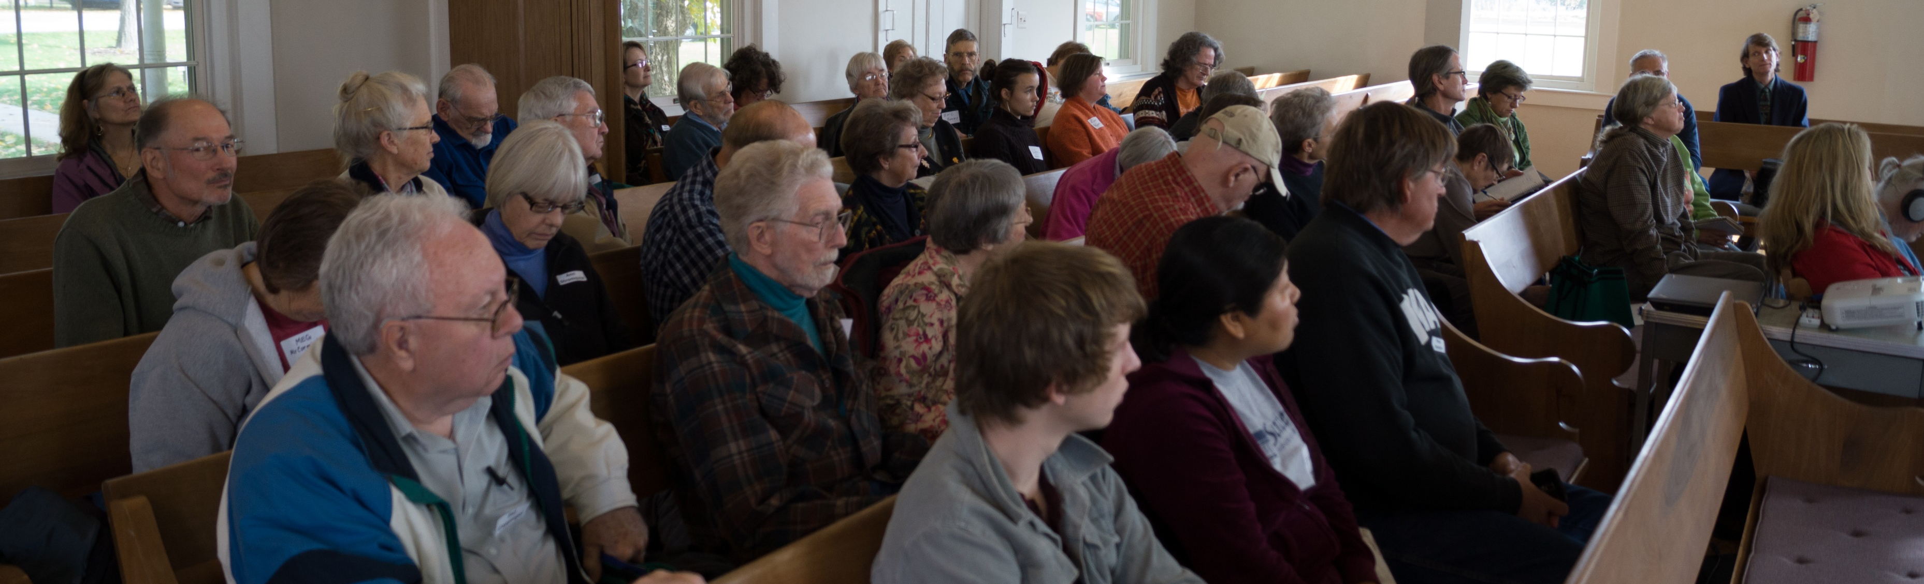
No hierarchy
We bring our learned practices of hierarchy with us
Even when no paycheck or punishment enforces our participation
Even in volunteer groups we often find ourselves in conflicts stemming from learned dominance behaviors.
But collective spaces, like mutual aid organizing, can give us opportunities to unlearn conditioning and build new skills and capacities.
“Mutual Aid is essential to our survival” by Dean Spade, Truthout, October 28, 2020

Slide 19
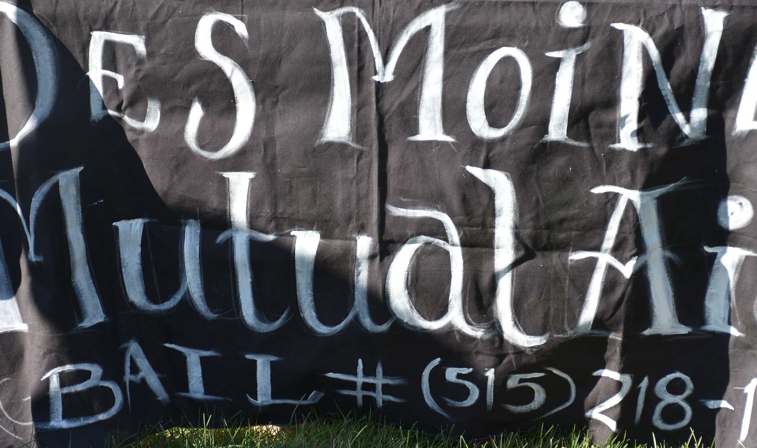
Des Moines Mutual Aid
Food giveaway
Houseless
Bail Fund

Slide 20
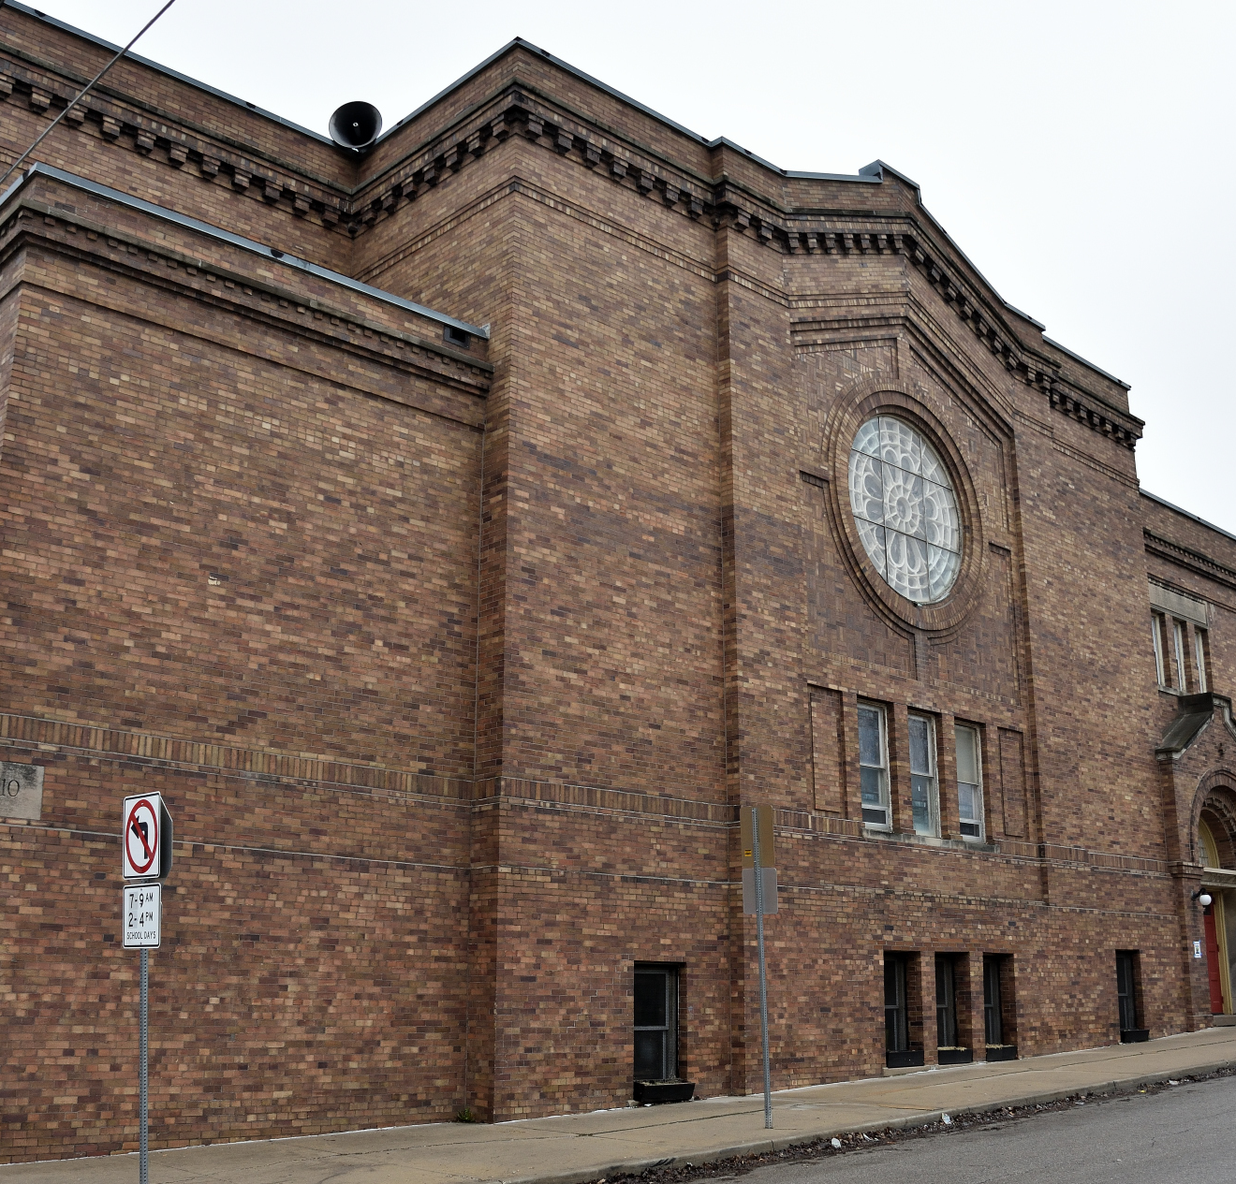
My experience with food giveaway
Mutual aid – we are all encouraged to take food ourselves
Dated food and donated vegetables
No hierarchy
Diversity
Joyful work
Empathize with those picking up food
COVID practices
Conversations

Slide 21
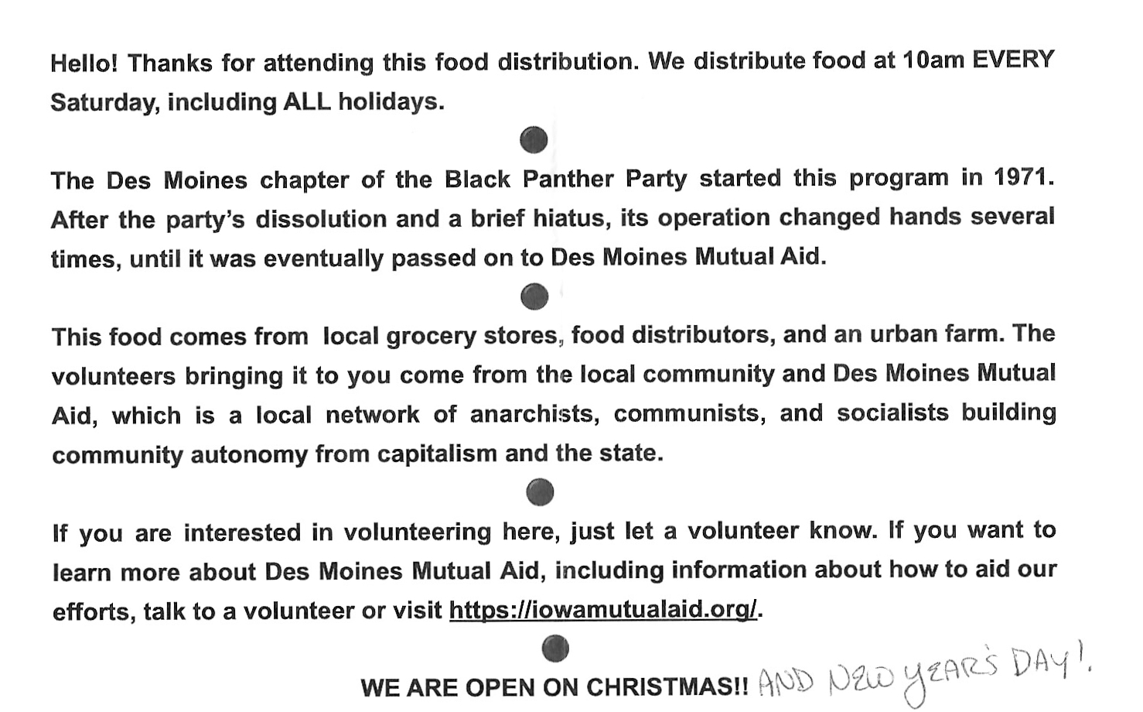
Des Moines Mutual Aid

Slide 22


Slide 23
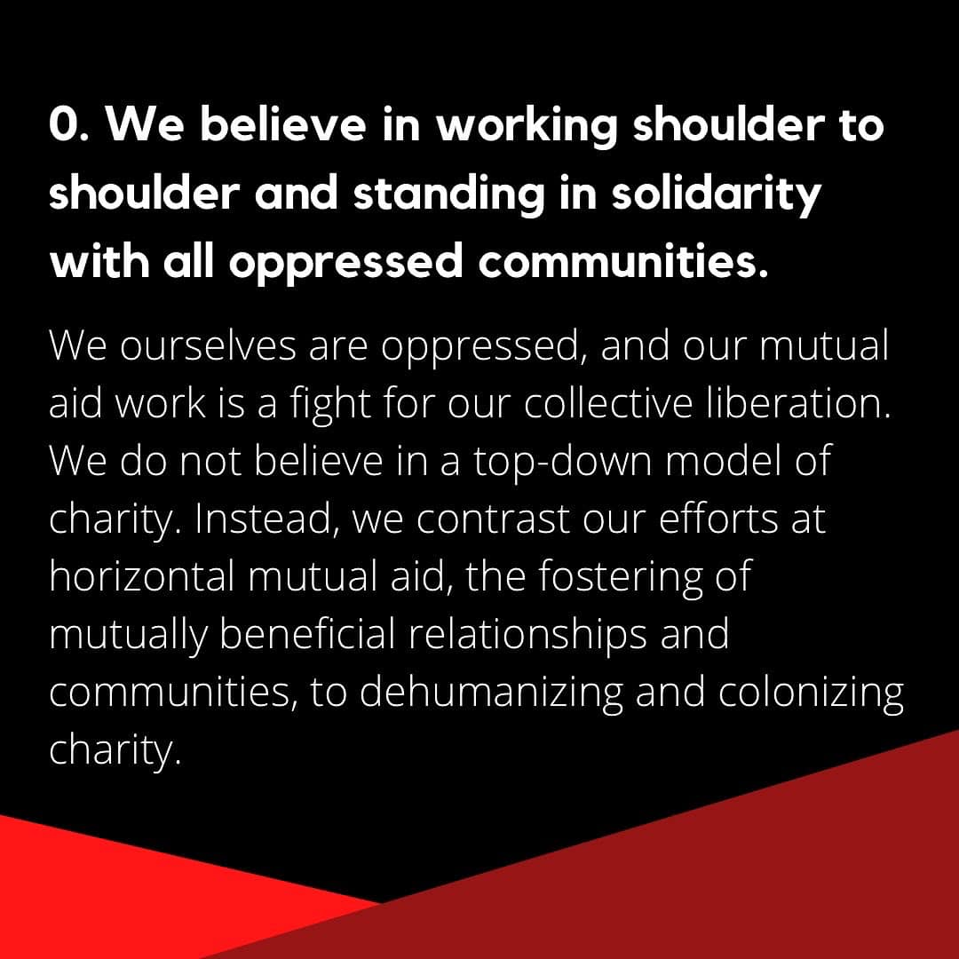

Slide 24
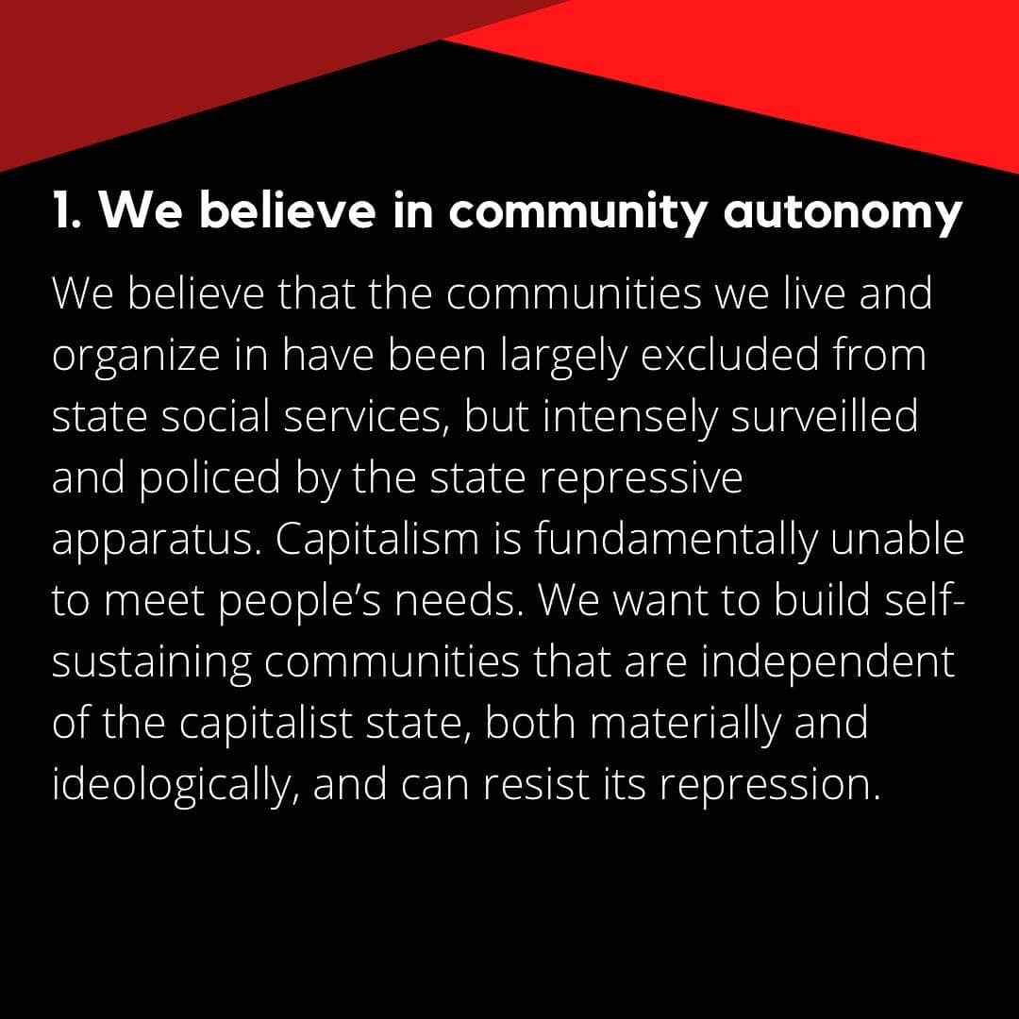

Slide 25
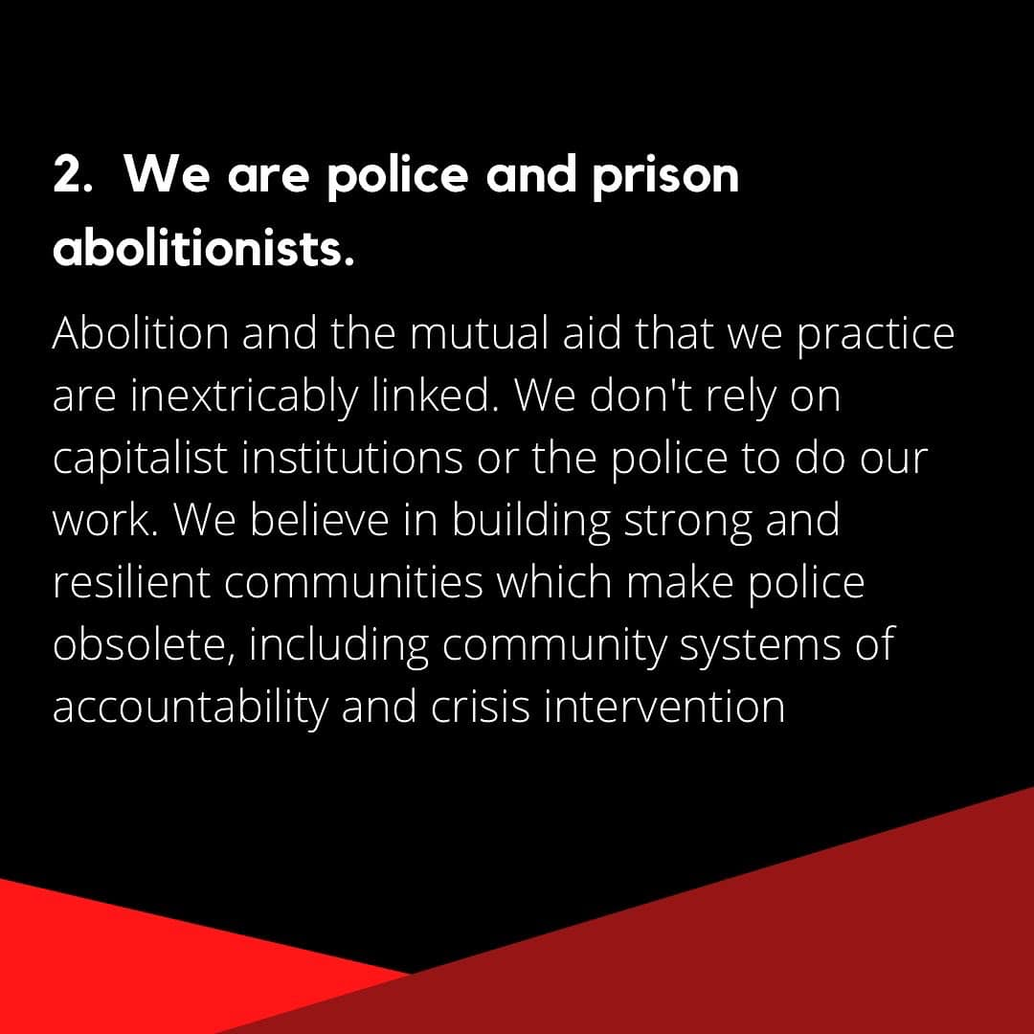

Slide 26
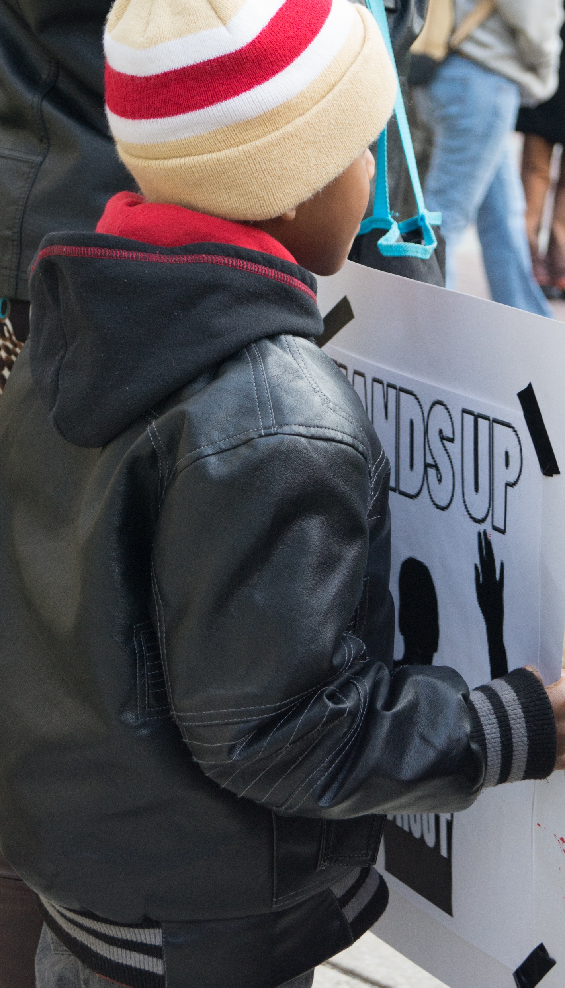
What we have is each other
As bleak as this is, there is a significant amount of resistance and hope to turn the tide we currently suffer under. We stand on the shoulders of giants that have been doing this work for centuries, and there are many lessons we can learn from.
The first, and possibly the most important, is that it was not always this way, which proves it does not have to stay this way.
What we have is each other. We can and need to take care of each other. We may have limited power on the political stage, a stage they built, but we have the power of numbers.
Ronnie James

Slide 27
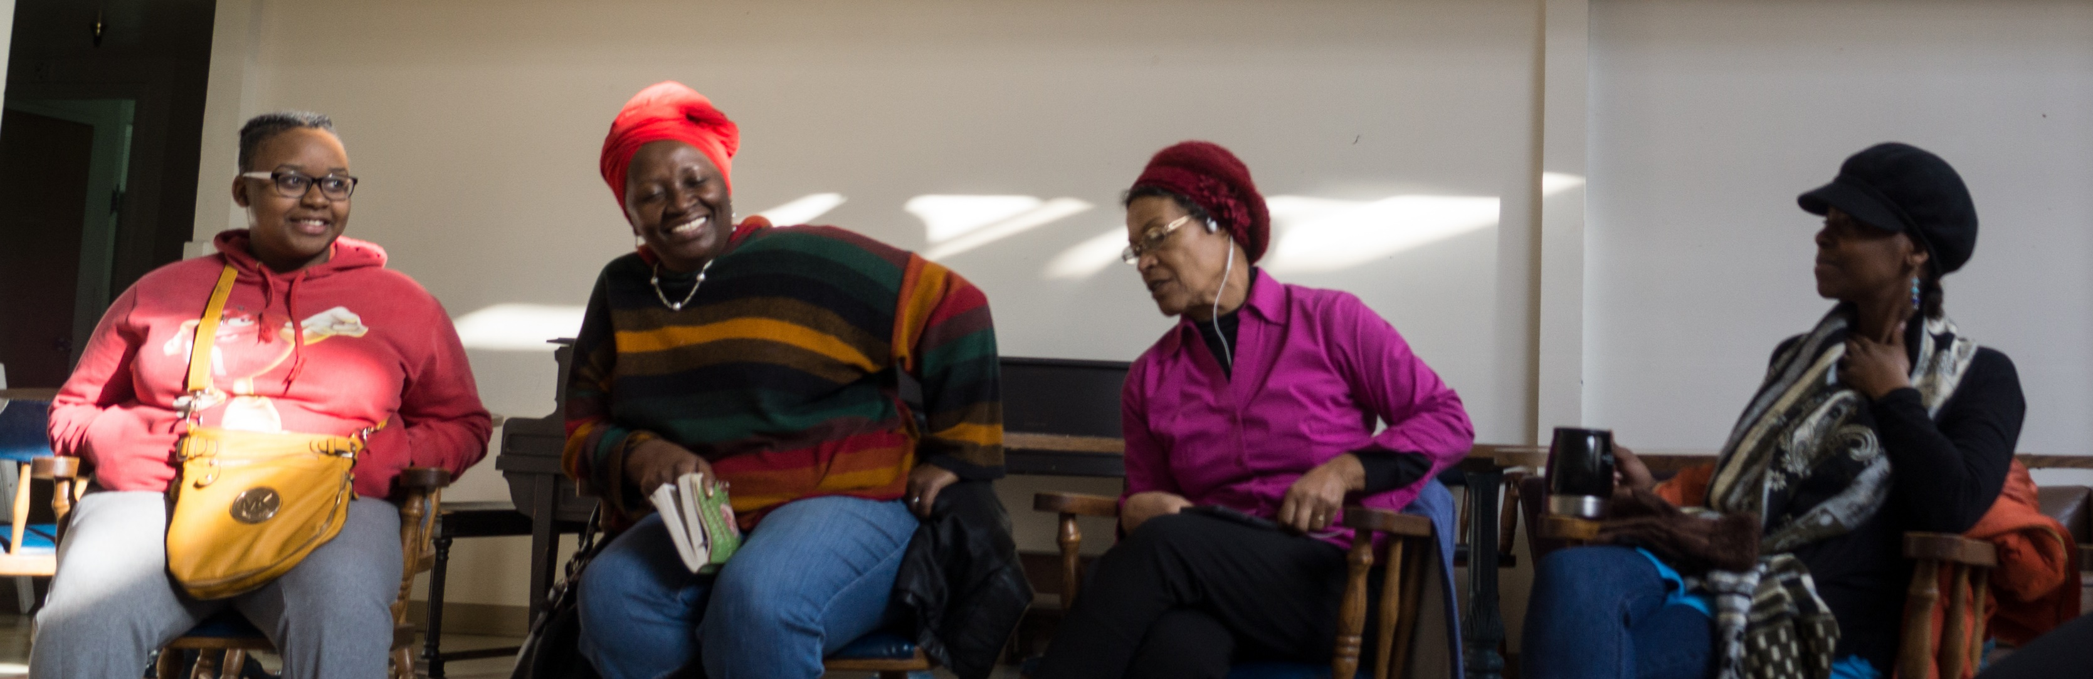
Mutual Aid versus Capitalism
I’m of the firm opinion that a system that was built by stolen bodies on stolen land for the benefit of a few is a system that is not repairable. It is operating as designed, and small changes (which are the result of huge efforts) to lessen the blow on those it was not designed for are merely half measures that can’t ever fully succeed.
Ronnie James

Slide 28
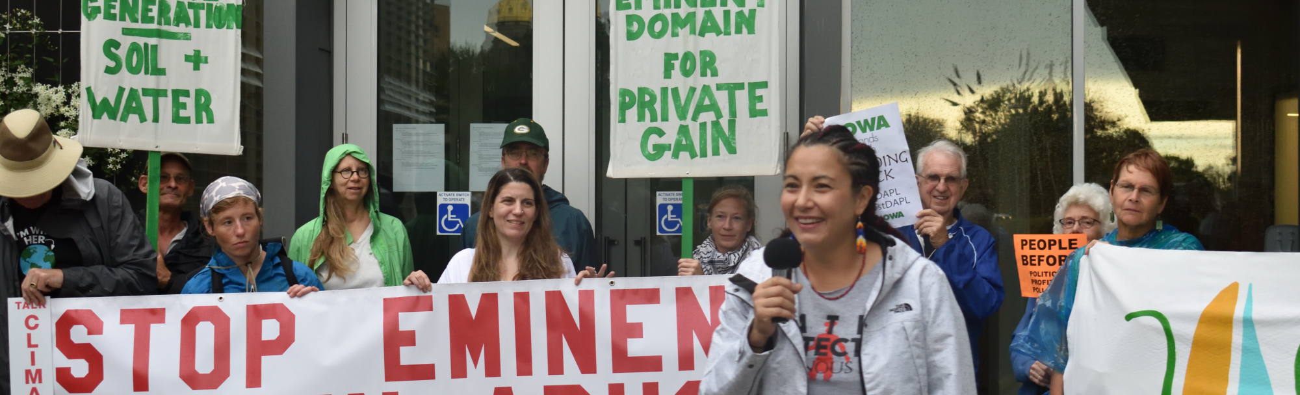
The question is
Do we continue to make incremental changes while the wealthy hoard more wealth and the climate crisis deepens?
Or do we do something drastic that has never been done before?
Can we envision and create a world where a class war from above isn’t a reality anymore?”
Ronnie James

Slide 29
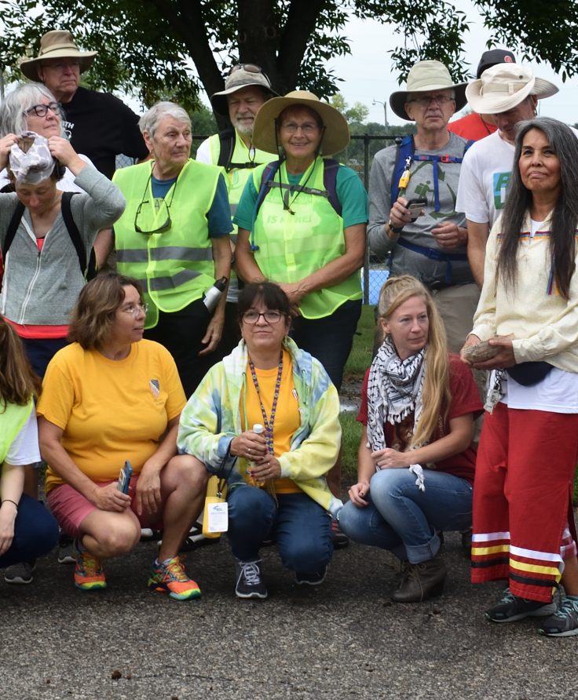
Build the world we want
By participating in groups in new ways and practicing new ways of being together, we are both building the world we want and becoming the kind of people who could live in such a world together.
“Mutual Aid is essential to our survival” by Dean Spade, Truthout, October 28, 2020

Slide 30
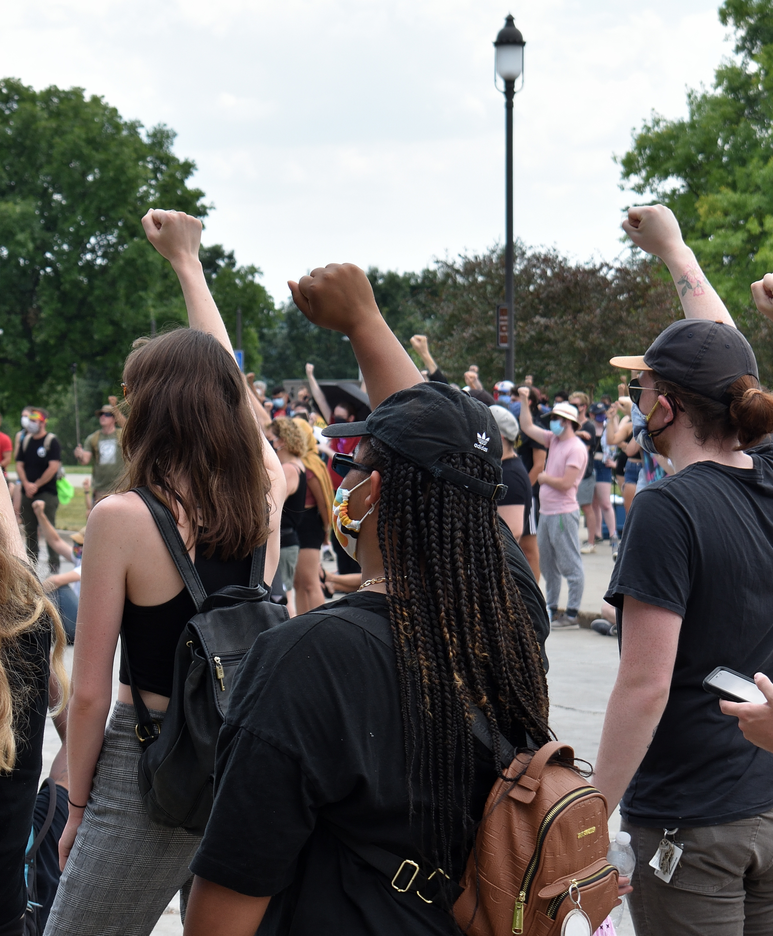
Envision that world our ancestors want for us
We each have skills and resources we can utilize towards the abolition project. Some of us can use the halls of the system to make short term change there, others have skills that produce food, provide medical care, or care for our precious youth, some are skilled in the more confrontational tactics needed. Once we envision that world our ancestors want for us, finding our role is natural.
If we are to survive, and more importantly, thrive, we know what we will have to do.
All Power To The People
Ronnie James

Slide 31
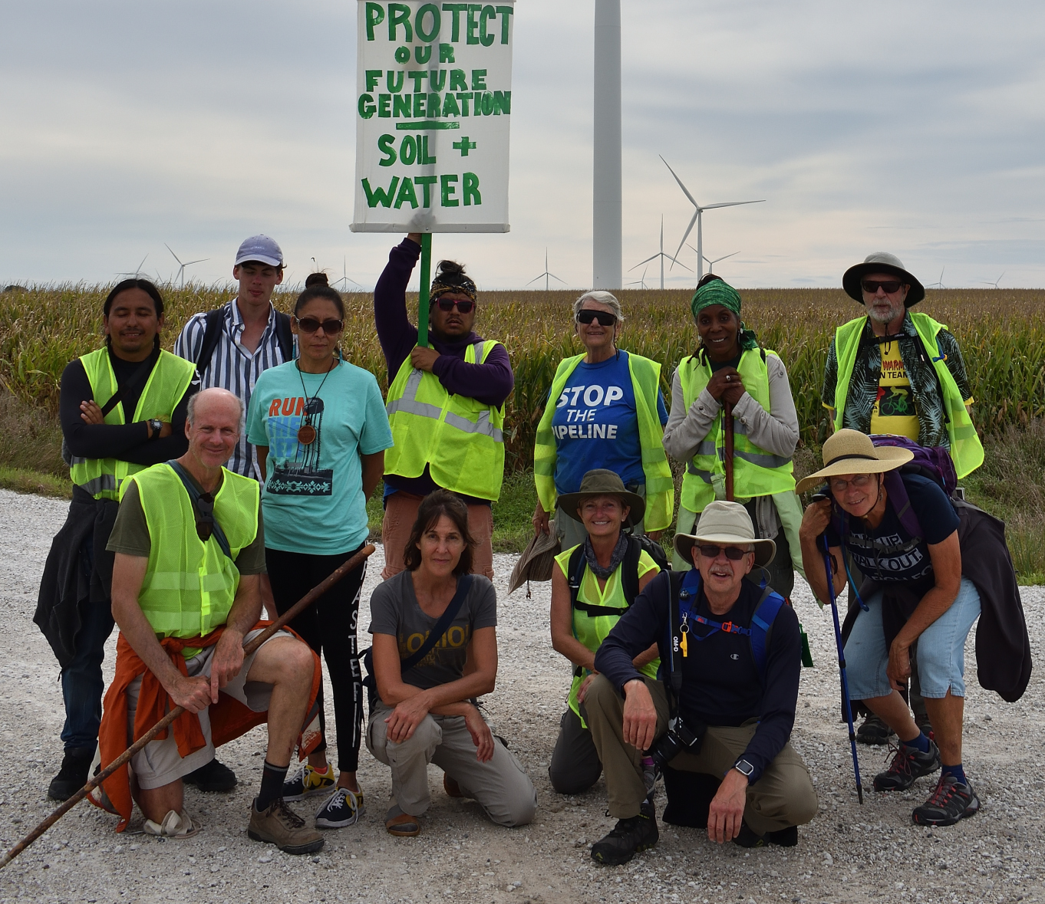
Mutual Aid
A tool of survival
A tool of revolution
A tool of faith
A Quaker way of being in the world
A radical act
In this context of social isolation and forced dependency on hostile systems, mutual aid— where we choose to help each other out, share things, and put time and resources into caring for the most vulnerable— is a radical and spiritual act.
It is a Quaker way of being in the world.

Slide 32
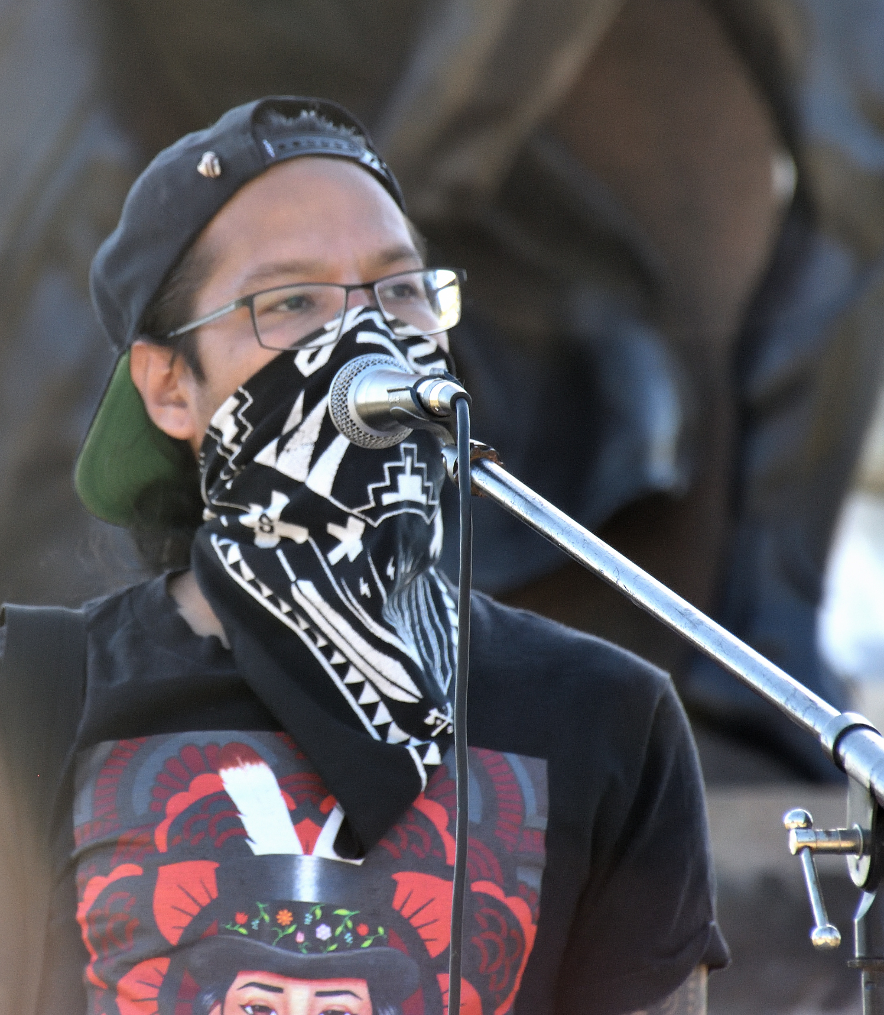
Mutual aid is not only a tool of survival, but also a tool of revolution.
The more we take care of each other, the less they can fracture a community with their ways of war
Ronnie James
Ronnie James

Slide 33
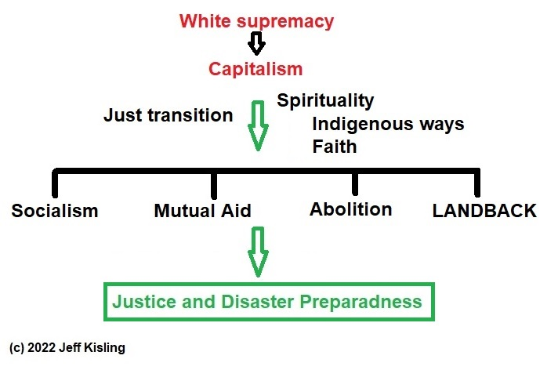
Mutual Aid,
Spirituality,
White supremacy and Capitalism

Slide 34
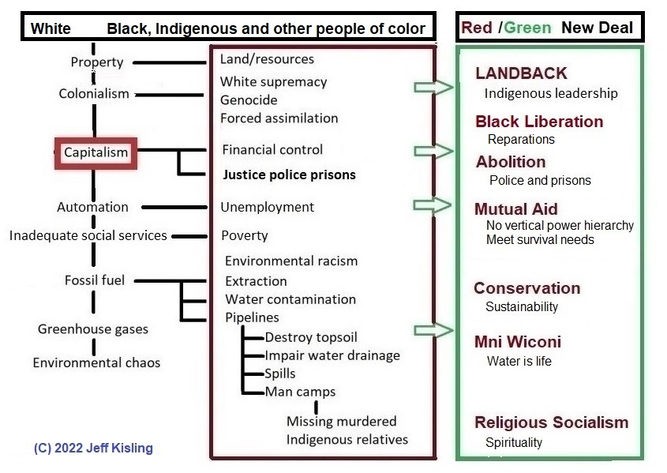

Slide 35
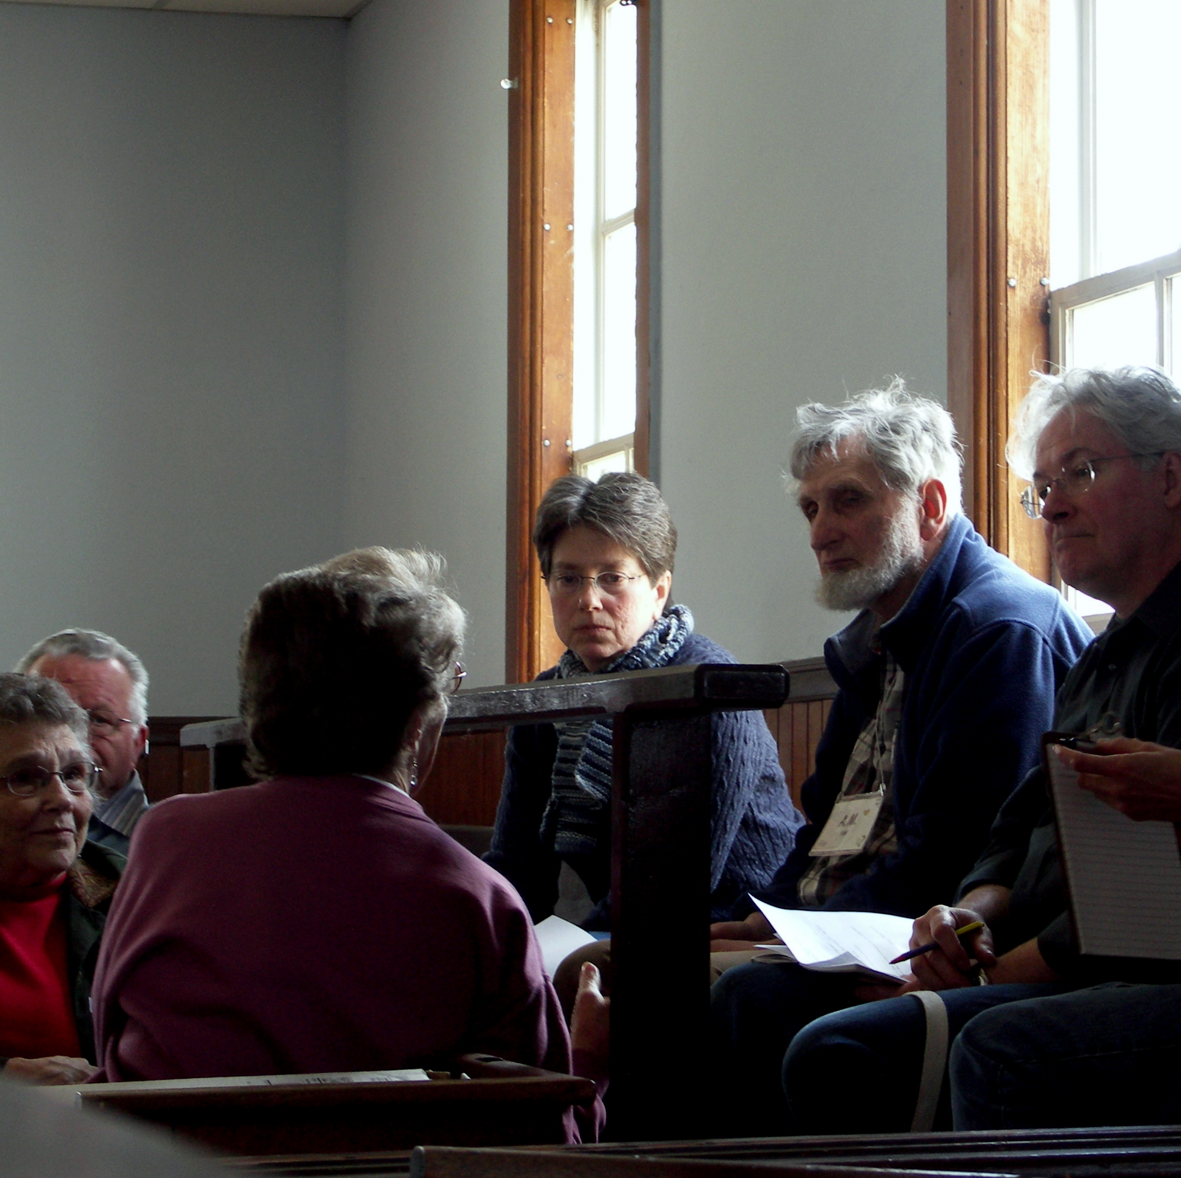
Next steps
What Mutual Aid groups are in your area?
What relationships do you see between your peace and justice work, and the concept of Mutual Aid?
What would your justice work look like if you adapted it to the Mutual Aid model?
How might faith integrate with Mutual Aid?
How could Mutual Aid expand who you do your justice work with?
  Bring in more Friends
  youth
  other people in your wider community?
How can we create ways of meeting our needs, making decisions, and organizing ourselves and solving problems outside of the State structure and the capitalist system?

Slide 36
Des Moines Mutual Aid
DM Mutual Aid
https://www.facebook.com/Des-Moines-Mutual-Aid-108955753983592/
DM Rent Relief
https://www.facebook.com/DSMBLMRentRelief/
DM Bail Fund
https://www.facebook.com/dsmbailfund

Slide 37
What is Mutual Aid?
Getting people together in your community to provide material and spiritual support to each other
Building relationships with your neighbors based on trust and common interest
Making decisions by consensus rather than relying on authority or hierarchy

